Slide 1
Vaccine Preventable Illness Writing Assignment
Amber Lyon-Colbert
H320 Intro to Human Disease

Slide 2
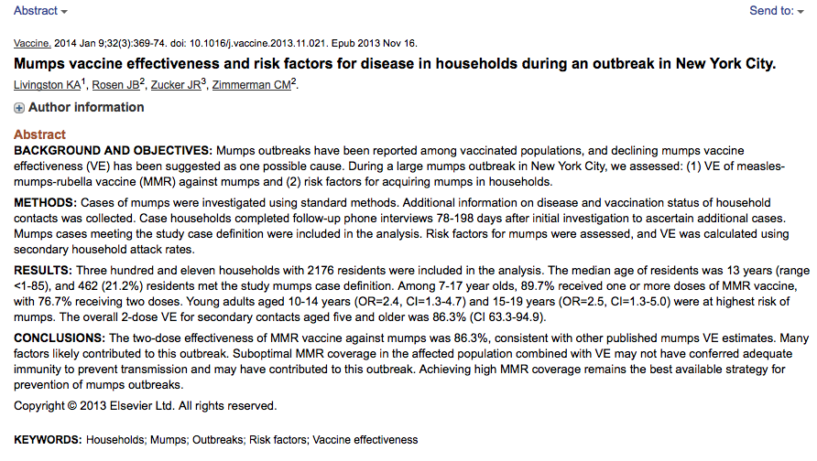
Find your Journal article:
Find a peer-reviewed article regarding a vaccine preventable illness from NCBI/ PubMed: http://www.ncbi.nlm.nih.gov/pubmed/

Slide 3
Ideas for writing:
Which vaccine preventable illnesses are on the rise?
Current outbreaks in the U.S.
Pockets of under-vaccination.
Herd immunity

Slide 4
3 component to assignment:
Identify and Describe a vaccine preventable illness (1-2 Paragraphs).
http://www.cdc.gov/vaccines/vpd-vac/
Potential for spread/ outbreaks and perceived public health importance (1 paragraph).
Provide your opinion on whether or not vaccines for this illness should be mandated by the United States (1 Paragraph).
Assignment should be 600-750 words.

Slide 5
Questions:
References should follow APA manual of Style
http://www.lib.jmu.edu/citation/amaguide.pdf
E-mail me with questions regarding your writing assignment or if you need help in finding a good article.

